Slide 1

Analyzing Cyber Attacks in WSNs using
Ensemble Techniques
by
Lakshmi Moksha B
Roll No. 224G1A3246
Dinesh Reddy C
Roll No. 224G1A3218
Karthik P
Roll No. 224G1A3239
Akash R
Roll No. 224G1A3206
Under the guidance of
Dr.P.Chitralingappa _{M. Tech,Ph.D.}
Associate Professor & HOD
Department of Computer Science and Engineering (Data Science)
Srinivasa Ramanujan Institute of Technology
(Affiliated to JNTUA & Approved by AICTE) (Accredited by NAAC with ‘A’ Grade & Accredited by NBA (EEE, ECE & CSE)
Rotarypuram Village, B K Samudram Mandal, Ananthapuramu – 515701.
2025 - 2026

Slide 2
Abstract
Analyzing Cyber Attacks In WSNs using Ensemble Techniques
Wireless Sensor Networks (WSNs) play a key role in Industry 4.0 by enabling real-time data sharing and monitoring. However, they are vulnerable to cyberattacks such as blackhole, grayhole, flooding, and scheduling, which threaten secure communication. Traditional methods like Decision Trees, Random Forests often have limited accuracy and adaptability. This research proposes a framework combining ensemble methods like Stacking, XGBoost and AdaBoost with deep learning models like MLP, Autoencoder to improve cyberattack detection in WSNs. By integrating multiple models, these techniques achieve greater accuracy in identifying and mitigating security threats. Experimental results demonstrate significant improvements in safeguarding sensitive data transmission across Wireless Sensor Networks.
A-10

Slide 3

Contents
Analyzing Cyber Attacks In WSNs using Ensemble Techniques
Detecting Cyber Attacks In WSNs using Ensemble Techniques
Abstract
Introduction
Literature survey
Proposed Work
References
GitHub Link
Queries
A-10

Slide 4
Introduction
Analyzing Cyber Attacks In WSNs using Ensemble Techniques
Detecting Cyber Attacks In WSNs using Ensemble Techniques
Industry 4.0 relies on Wireless Sensor Networks (WSNs) for automation, smart monitoring, and real-time data sharing.
These networks are highly vulnerable to cyberattacks such as blackhole, grayhole, flooding, and scheduling, which disrupt secure communication.
Traditional models like Decision Trees, Random Forest and have limited accuracy, adaptability, and resilience.
Ensemble methods such as Stacking, XGBoost, and AdaBoost combined with deep learning models like MLP and Autoencoder provide stronger detection.
The WSN-DS dataset shows that the framework can effectively detect and classify different types of cyberattacks.
A-10

Slide 5
Literature Survey
Analyzing Cyber Attacks In WSNs using Ensemble Techniques
Detecting Cyber Attacks In WSNs using Ensemble Techniques
No | Title | Author | Journal Name & Year | Methodology Adapted | Key Findings | Gaps
1. | A Situation Based Predictive Approach for Cybersecurity Intrusion Detection and Prevention Using Machine Learning and Deep Learning Algorithms in Wireless Sensor Networks of Industry 4.0 | FATIMA AL-QUAYED , ZULFIQAR AHMAD AND MAMOONAHUMAYUN | I2CT ( IEEE 9th International Conference for Convergence in Technology) 2024 | Decision Tree, MLP, Autoencoder | Effective detection of WSN attacks using single model | Uses only single models at a time, does not combine methods or adapt to evolving attacks
2. | Evaluation of Machine Learning Algorithms for Intrusion Detection System in Wireless Sensor Network | Mousa Tawfiq AL-Akhras , Mohammed Alawairdhi | International Journal of Advanced Computer Science and Applications 2021 | Naive Bayes , Random Forest Algorithm | Analyze and protect WSN networks in combination with firewalls and Deep Packet Inspection | Not suitable for the advanced cyber attacks like Grey hole, Flooding.
A-10

Slide 6
Proposed System
Analyzing Cyber Attacks In WSNs using Ensemble Techniques
Detecting Cyber Attacks In WSNs using Ensemble Techniques
Implements a situation-based predictive approach using Ensemble Techniques to tackle growing cyber threats in Wireless Sensor Networks (WSNs) for Industry 4.0.
Identifies and prioritizes cyber threats such as Blackhole and Flooding attacks before they can cause significant damage.
Leverages advanced algorithms like Bagging, XGBoost, and AdaBoost to improve accuracy and adaptability of cybersecurity defenses.
Overcomes limitations of traditional reactive systems by analyzing real-time data to detect complex attack patterns.
Ensures quicker responses to potential threats through predictive Ensemble models, reducing risks and vulnerabilities.
Maintains secure and uninterrupted operations in Industry 4.0 environments by detecting threats proactively and minimizing disruptions
A-10

Slide 7
Reference
Analyzing Cyber Attacks In WSNs using Ensemble Techniques
Detecting Cyber Attacks In WSNs using Ensemble Techniques
[1]. Fatima Al-Quayed, Zulfiqar Ahmad, and Mamoona Humayun's paper, "A Situation-Based Predictive Approach for Cyber Attacks Detection and Prevention Using Machine Learning and Deep Learning Algorithms in Wireless Sensor Networks of Industry 4.0," was published in IEEE Access, Volume 99, Pages 1-1, in January 2024 (DOI: 10.1109/ACCESS.2024.3372187).
[2]. Mohammed S. Alsahli, Marwah M. Almasri, Mousa Al-Akhras, Abdulaziz I. Al-Issa, and Mohammed Alawairdhi, “Evaluation of Machine Learning Algorithms for Intrusion Detection System in Wireless Sensor Network,” International Journal of Advanced Computer Science and Applications (IJACSA), Volume 12, Issue 5, 2021, with a CC BY-NC-ND 4.0 license.
Shaik Razia and Venkata Ramani Varanasi's paper, "Intrusion Detection using Machine Learning and Deep Learning," was published in International Journal of Recent Technology and Engineering (IJRTE), Volume 8, Issue 4, in December 2019 (DOI: 10.35940/ijrte.D9999.118419), with a CC BY-NC-ND 4.0 license.
A-10

Slide 8
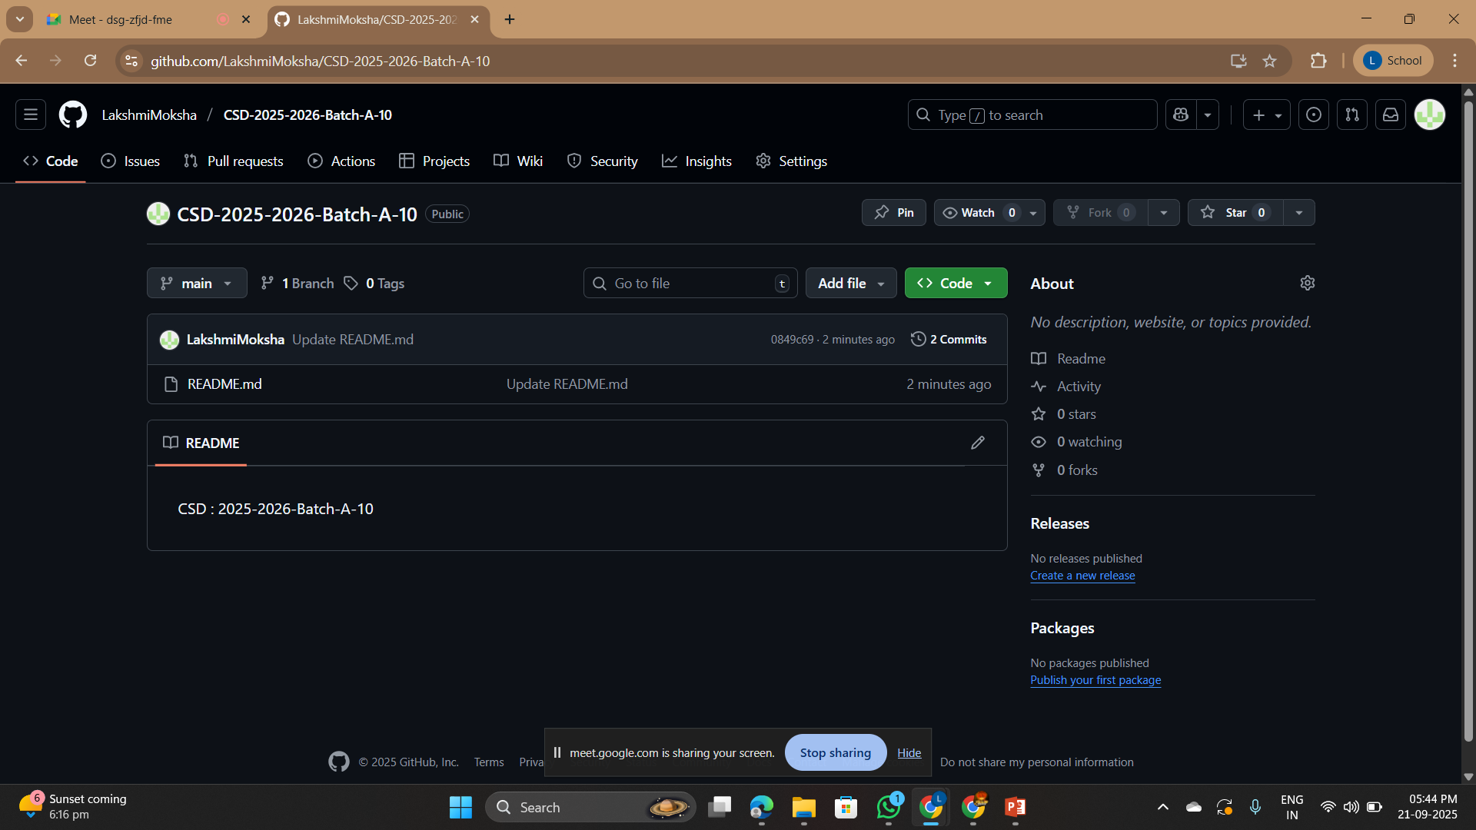
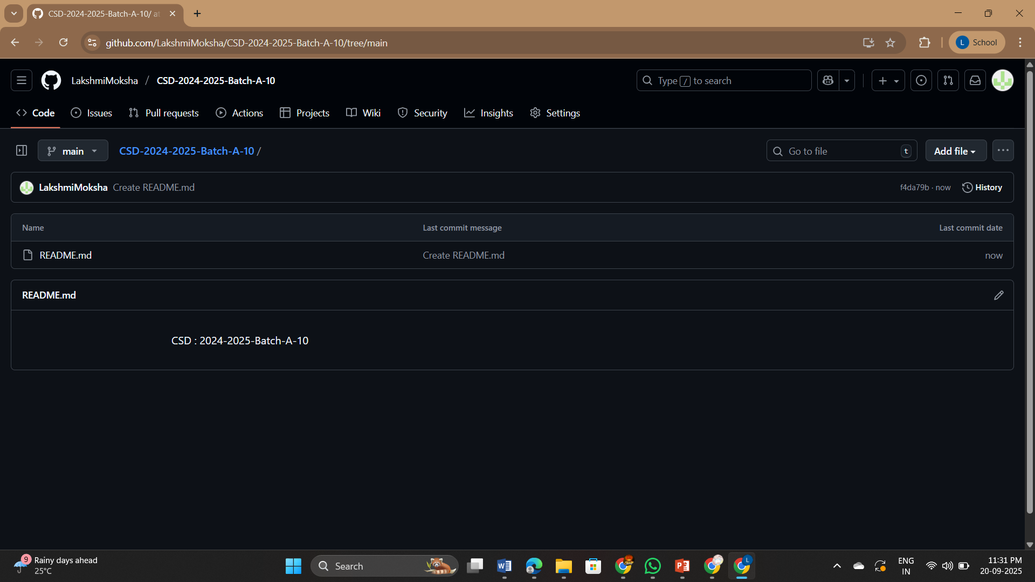
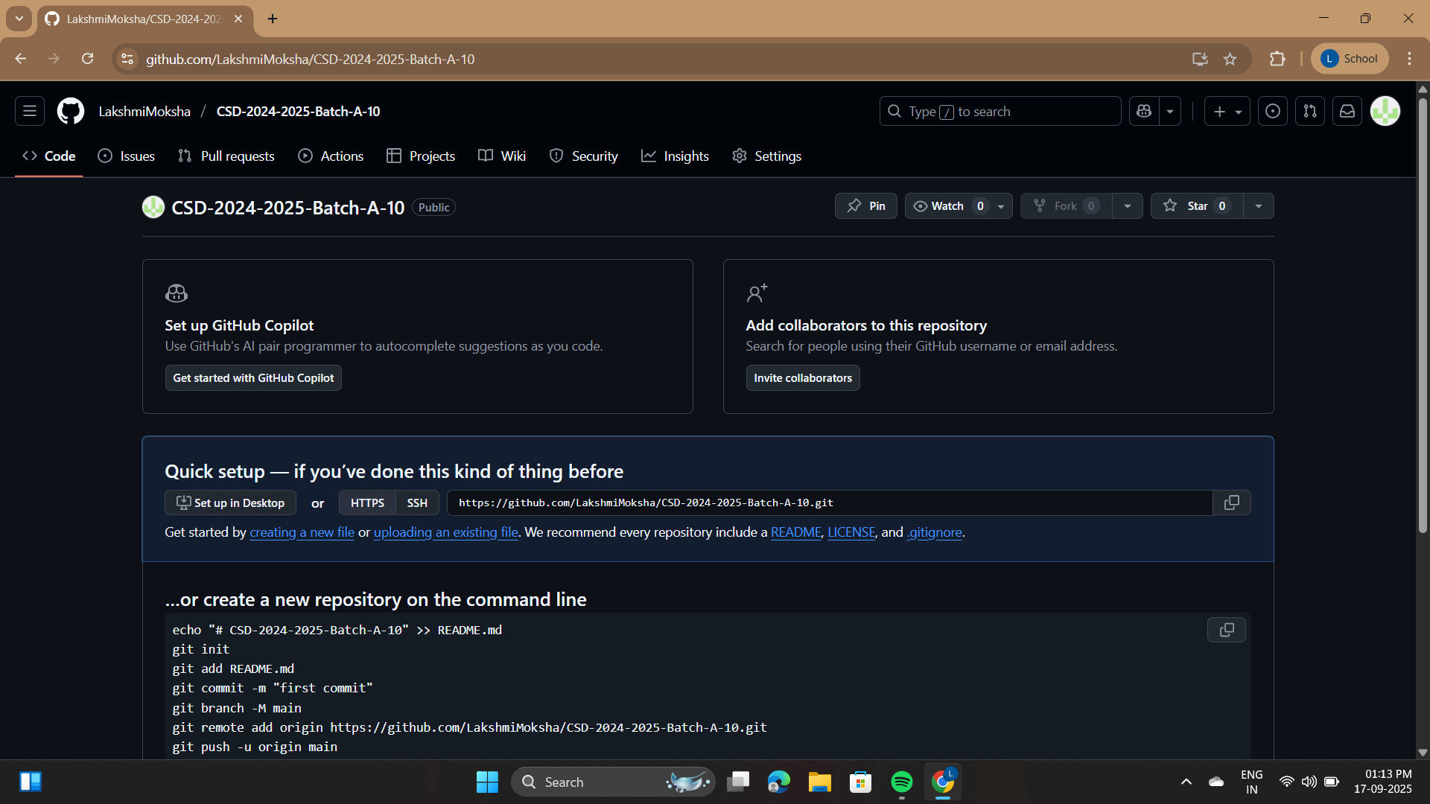


Git Hub Dashboards of each student
Analyzing Cyber Attacks In WSNs using Ensemble Techniques
Detecting Cyber Attacks In WSNs using Ensemble Techniques
GitHub link: https://github.com/LakshmiMoksha/CSD-2025-2026-Batch-A-10
A-10

Slide 9
Analyzing Cyber Attacks In WSNs using Ensemble Techniques
Detecting Cyber Attacks In WSNs using Ensemble Techniques
Any Queries?
A-10

Slide 10
Analyzing Cyber Attacks In WSNs using Ensemble Techniques
Detecting Cyber Attacks In WSNs using Ensemble Techniques
Thank You!!!
A-10

